Slide 1
Preaching Calendars
221
Planning for Your Future
Dr. Rick Griffith • Jordan Evangelical Theological Seminary • BibleStudyDownloads.org

Slide 2
Why Plan?
221
Topics Decided
No Repetition
Cohesiveness
Relationships
Leadership
Illustrations
Balance

Slide 3
How to Make an Effective Preaching Calendar
221
Have your personal devotions this year on the topics or books for your preaching next year
List books & topics needed

Slide 4
Next Year's Topics
221
Basics of the Faith
Church Life
Spiritual Gifts
Attributes of God
Elders
Bible Survey
Bible Study Methods
Genesis
Jonah
Malachi
1 John
Mark
Ephesians
James

Slide 5
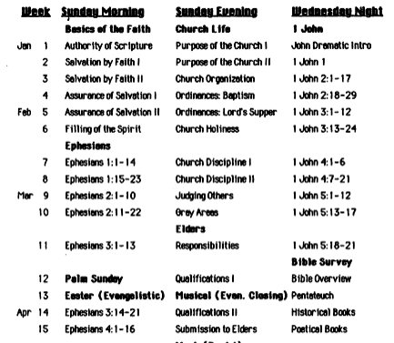
A Sample Calendar
222

Slide 6
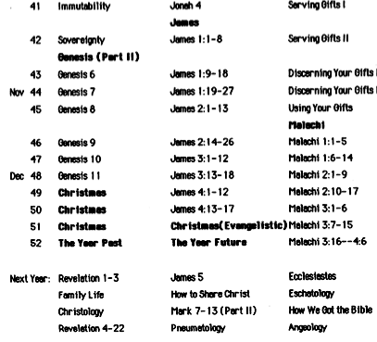
A Sample Calendar
222

Slide 7
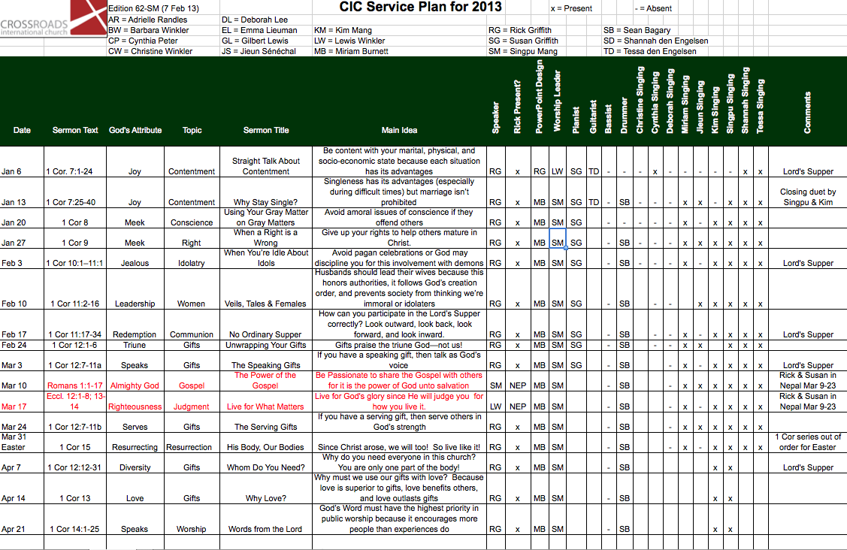
A More Detailed Calendar
223a

Slide 8
Adam Road Presbyterian Centre 2012 Handbook publicizes sermons a year in advance
223b

Slide 9
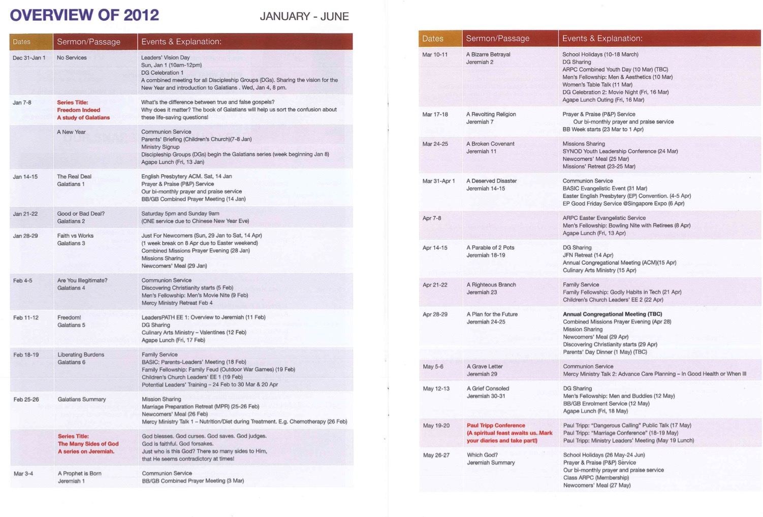
ARPC Careful Planning
223c-d

Slide 10
Black

Slide 11
Preaching (Homiletics) link at BibleStudyDownloads.org
Get this presentation for free!
Notes:
Preaching (pr)
Homiletics

